Slide 1
Introduction to ITIL V3

Slide 2
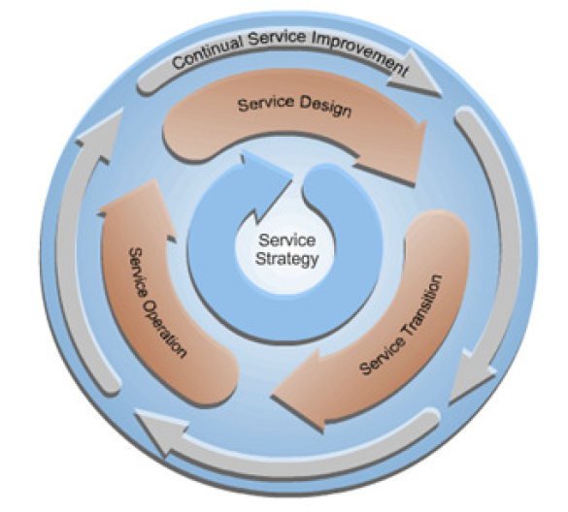

Slide 3
Key Concepts
Best and Good Practice
Best Practice provides a set of generic guidelines based on the successful experiences of a number of organizations.
- Good Practice could either be an application of best practice or it could be an input to Best Practice.

Slide 4
Basic Concepts: IT Services
- A service is a means of delivering value to customers by facilitating outcomes customer want to achieve without the ownership of specific costs and risks.
- An IT service, used in support of business processes, is constructed from a combination of IT assets and externally provided “underpinning” services.

Slide 5
Basic Concepts: Service Management
Service Management is a set of specialized organizational capabilities for providing values in the form of services.
Service Management Capabilities:
Exist as processes and functions
Manage services over a lifecycle
Specializes in strategy, design, transition, operation and continual improvement.
Represent capacity, competency and confidence for action.
Add value for customer and are shaped by challenges.
The act of transforming resources into services is the core of Service Management.

Slide 6
Basic Concepts: Characteristics of a Process
It is Measurable;
It delivers Specific results;
Primary results are delivered to the customer or stake holder;
It responds to specific events.

Slide 7
Process Owner
Responsible for:
Assisting with Process Design;
Documenting the process;
Making sure that the process is performed as documented;
Making sure that the process meets its aims;
- Monitoring and improving the process over time.

Slide 8
Service Owner
Responsible for:
Is responsible to the customer for a particular service which encompasses:
- Initiation and Transition;
- Ongoing maintenance and support;
- Monitoring and Reporting;
- Identifying improvement opportunities;
- Prime customer contact.

Slide 9
RACI Model
Can be used to help define roles and responsibilities.
It defines the activities that must be performed alongside the various individuals and roles involved.
RACI is the acronym for the four main roles of:
Responsible : The person/people responsible for getting the job done.
Accountable : Only one person can be accountable for each task.
Consulted : The people who are consulted and whose opinions are sought.
Informed : The people who are kept up-to-date on progress.

Slide 10
Deming’s Cycle
Plan: Goals and measures for success are established, A gap analysis is performed, Action steps to close the gap are defined, Measures to ensure the gap was closed are established | Do: Development and implementation of a project to close the identified gaps. Implementation of the improvement to Service Management processes. Establish the smooth operation of the process
Check: The implemented improvements are compared to the measures of success established during PLAN phase. This helps to establish if a gap still exists. | Act: A decision to keep the status quo or close the gap.

Slide 11
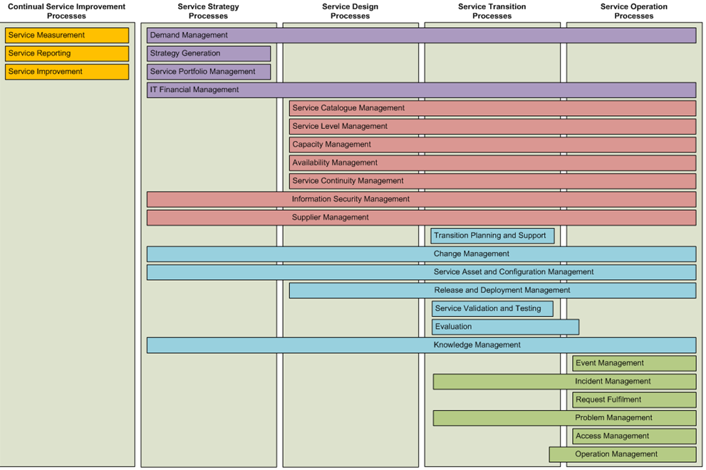
Service LifeCycle Process

